Slide 1
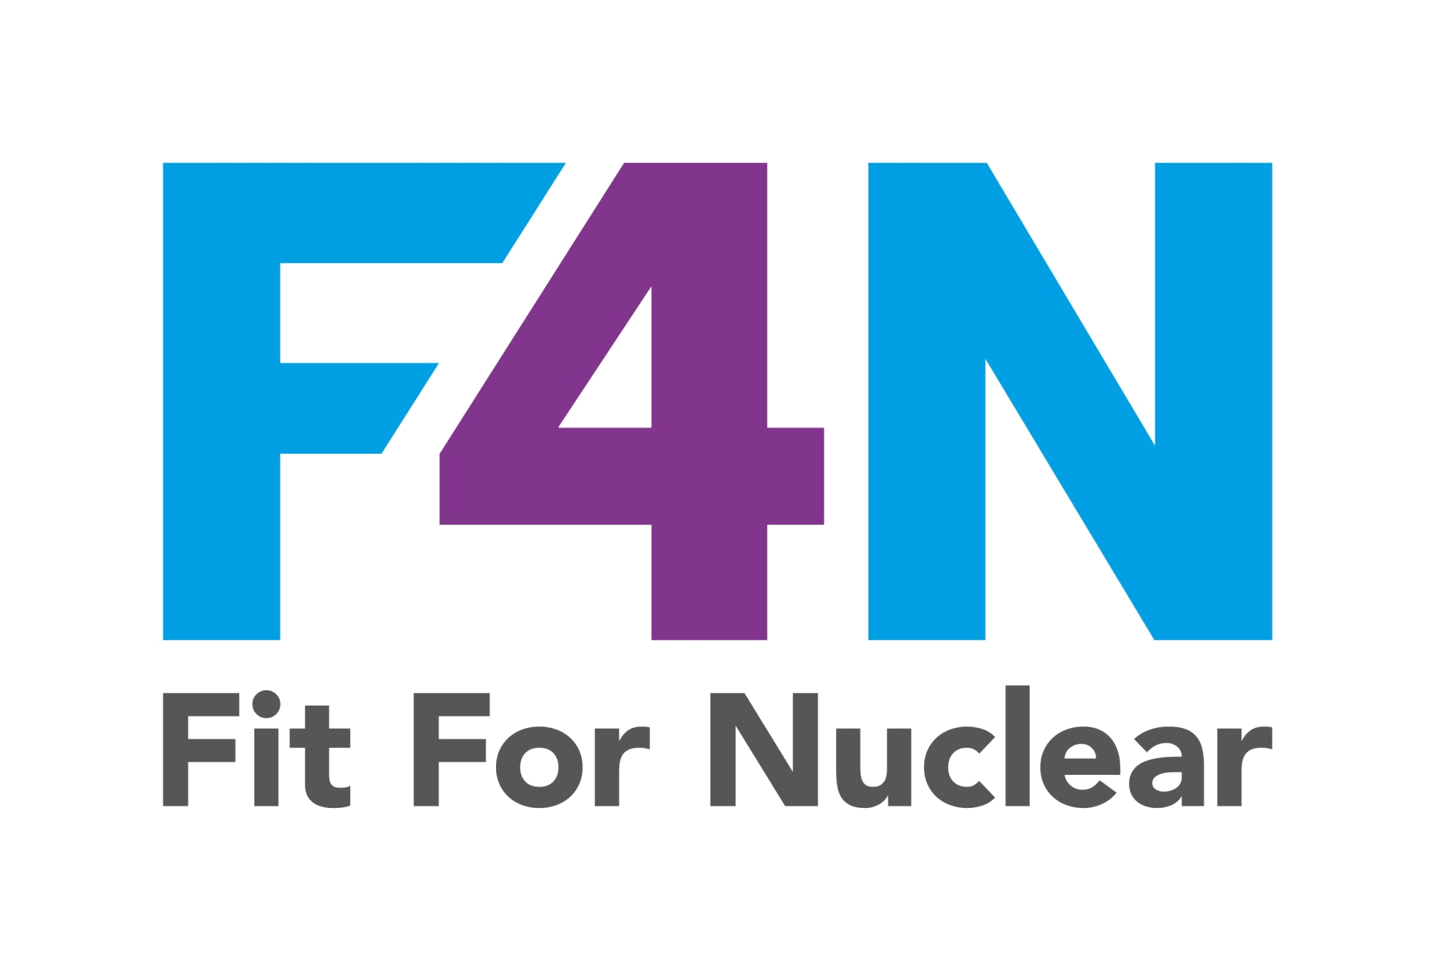
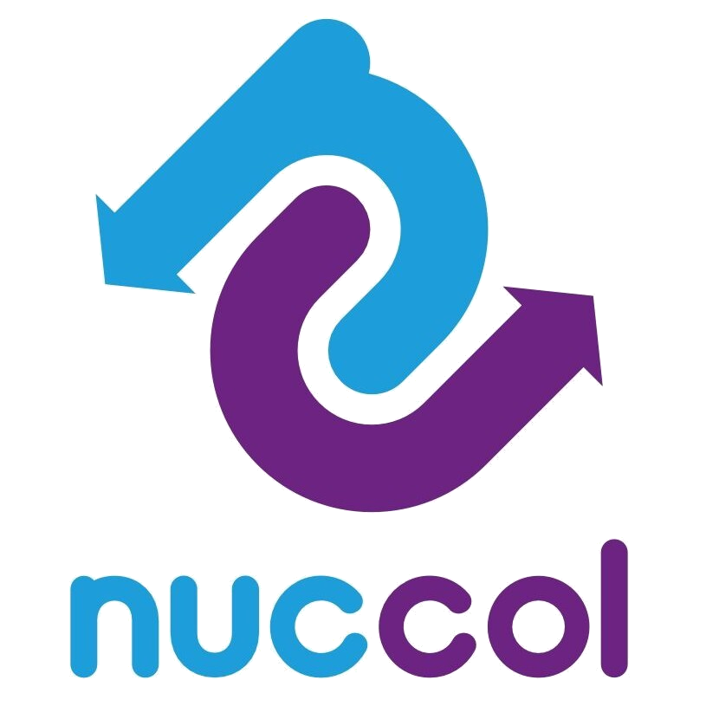
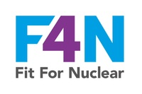
WHAT IS NUCLEAR SAFETY?
Keeping nuclear materials controlled and contained, always.
Nuclear safety means ensuring it is virtually impossible for an event to occur that could harm people or the environment. Every layer of our work contributes to this.
DEFENCE IN DEPTH: MULTIPLE LAYERS OF PROTECTION
!
Design
Manufacture
Inspection
Documentation
Installation
If a problem gets through one layer, the next layer is designed to catch it. Every layer must do its job properly.
Your work, whatever it is, is one of these layers. Doing it right, every time, is how nuclear stays safe.
NucCol | Nuclear Collaboration Ltd · Fit For Nuclear Programme · Commercial in Confidence | 1

Slide 2




WHY EVERY ROLE MATTERS TO NUCLEAR SAFETY
Nuclear safety is not just for engineers. It is everyone's job.
Production / Manufacturing
Quality and Inspection
Get it right first time. A small error here can become a safety issue later.
Catch problems before they leave the building. Your sign-off matters.
Purchasing and Goods Receipt
Everyone Else
Check what comes in. CFSI starts with vigilance at the door.
Follow procedures, raise concerns, ask questions. Never assume someone else has it covered.
NucCol | Nuclear Collaboration Ltd · Fit For Nuclear Programme · Commercial in Confidence | 2

